Slide 1


PROCESS INNOVATION Project Final Pitch
Team 4
Arun Palani
Bala Sameeksha Pulaparthi
Harinishree Balaji
Hyndavi Nidadavolu

Slide 2


Service Overview
Application: GPS navigation app Parent Company: Google
Competitors: Google Maps, Apple Maps

Slide 3

Market Context

Slide 4
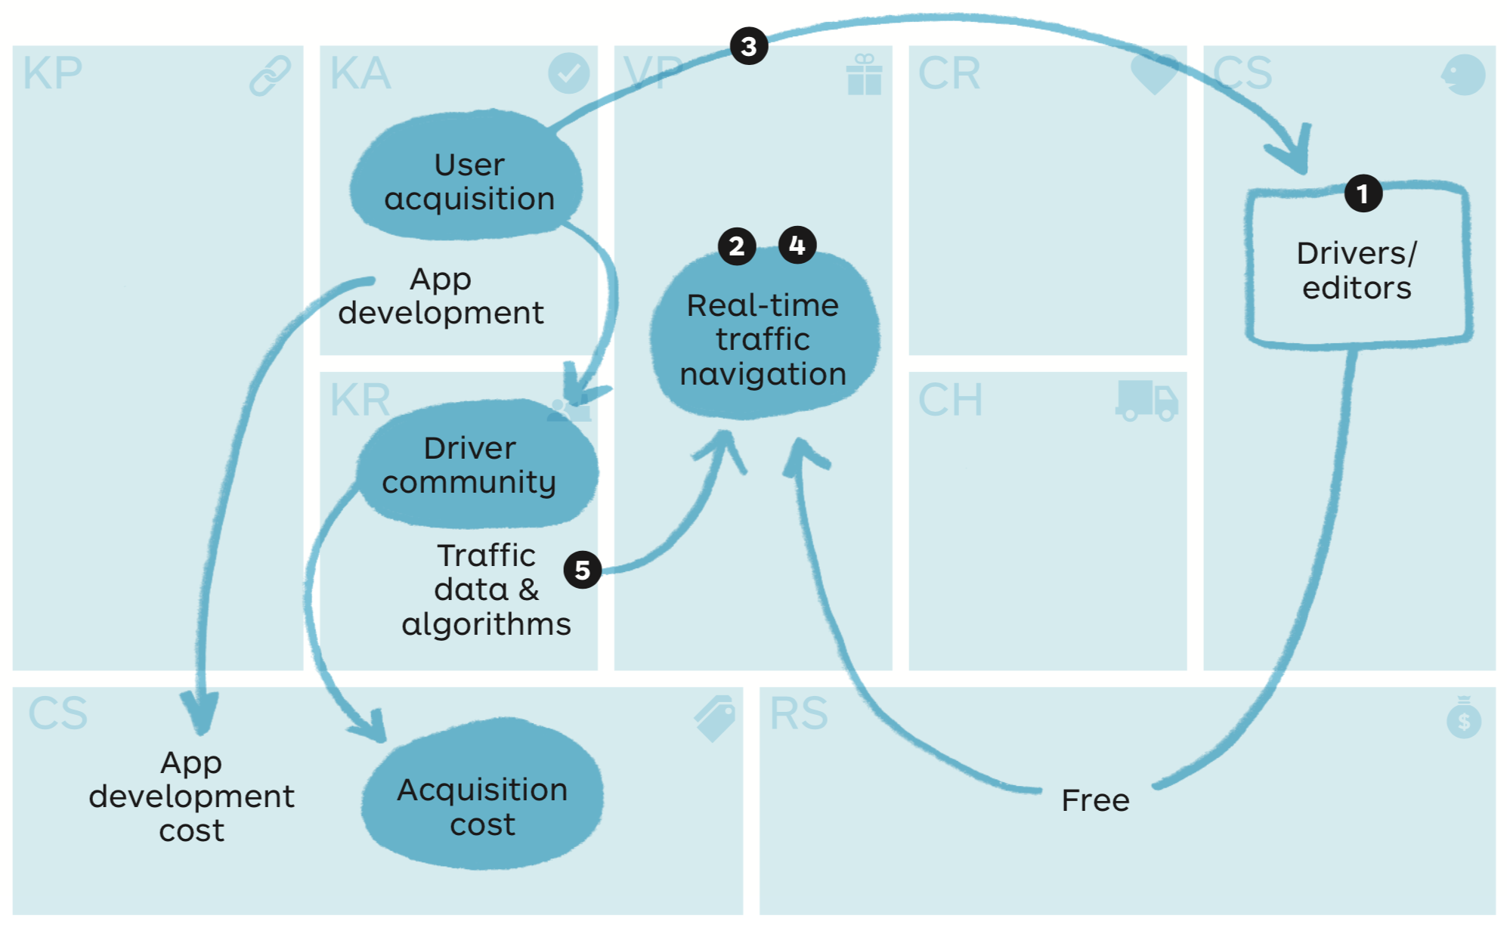
Waze Business model

Slide 5
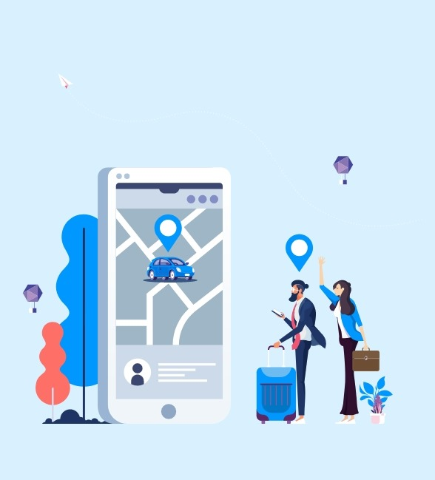
TARGET CUSTOMERS

Slide 6
Who are they?
Tourists and Travelers
Delivery and Transportation Services
Ride-sharing peers

Slide 7
What “job” are they trying to get done?
To get directions to a place/destination.

Slide 8

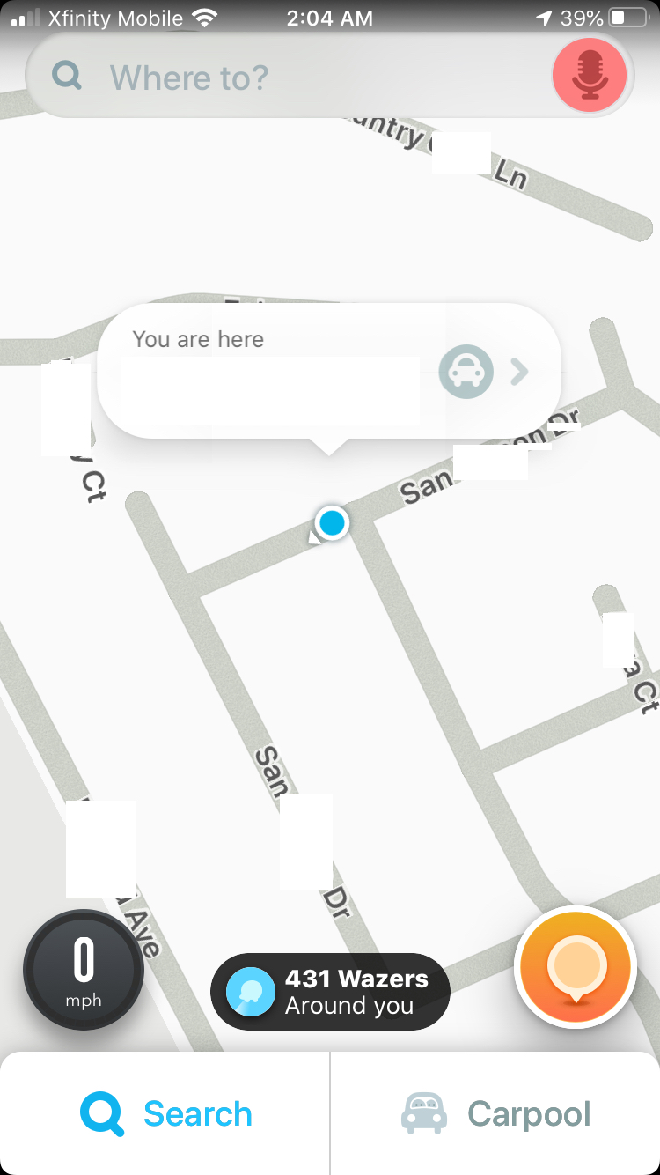
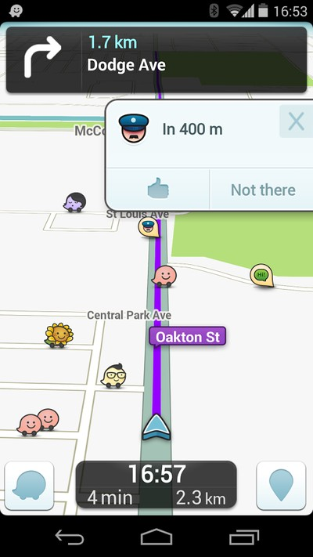
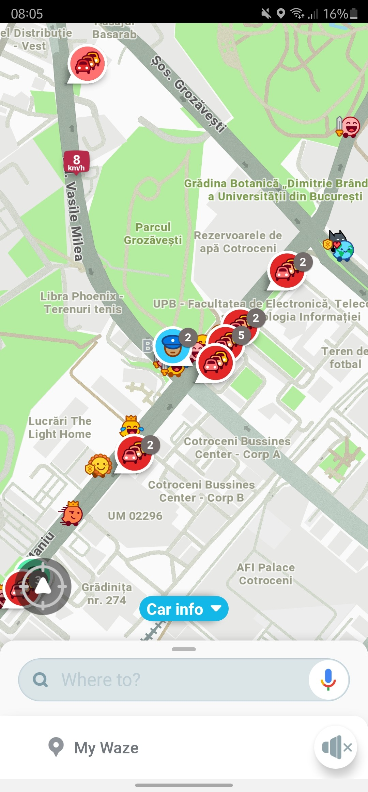
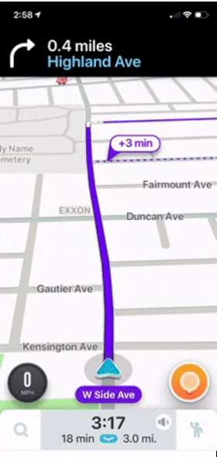
Moments of struggle(MOS)
How are they struggling to get that job done?
DESTINATION SELECTION
DYNAMIC ADJUSTMENTS
ROUTE CALCULATION
DESTINATION ARRIVAL TIME

Slide 9
Customer Value Metrics(CVMs)
Destination Selection Ease
Route Optimization Accuracy
ETA Accuracy
Reliable Arrival time
65%
70%
70%
65%
80%
85%
85%
80%

Slide 10
VLIFT Strategies
for Enhanced CVMs

Slide 11
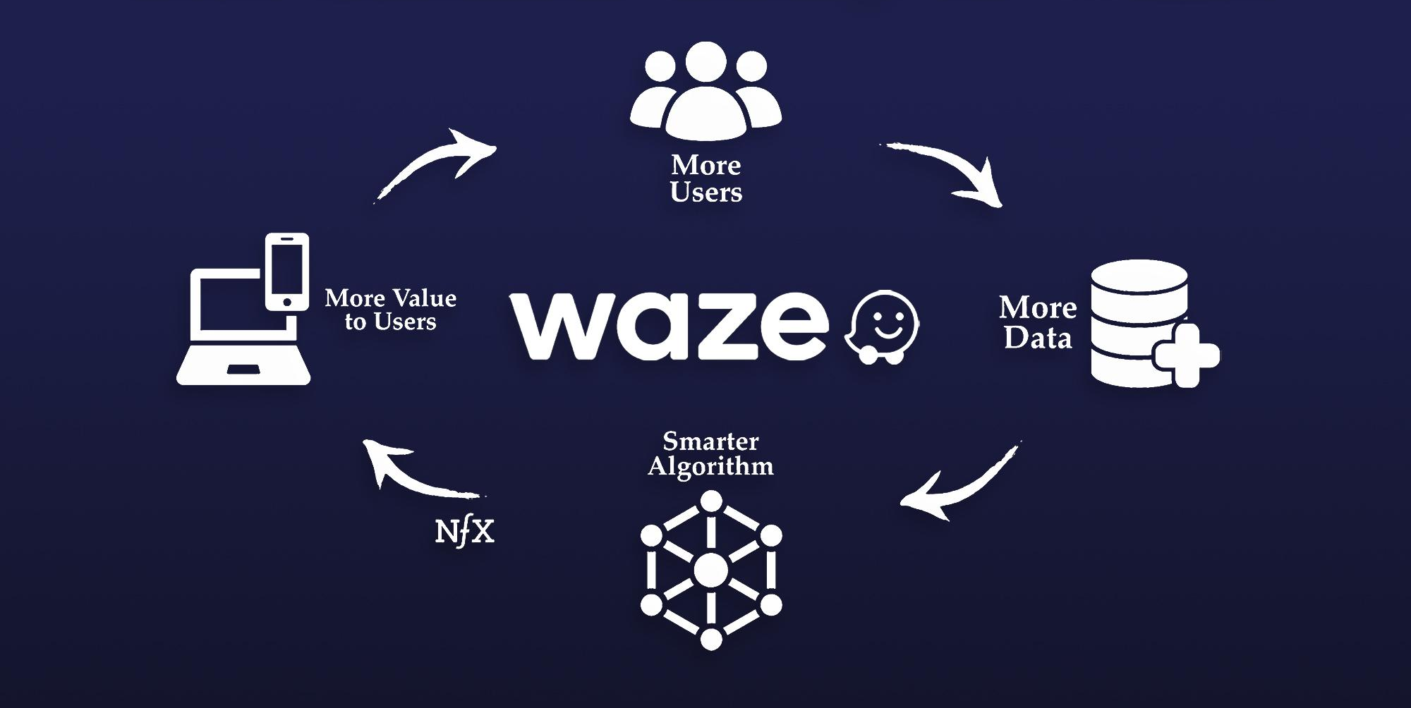
Address service gaps
Personalize search and route options
Streamlining, connected vehicle technology
Account for reliable variability
AI-powered, enhanced machine learning algorithms

Slide 12
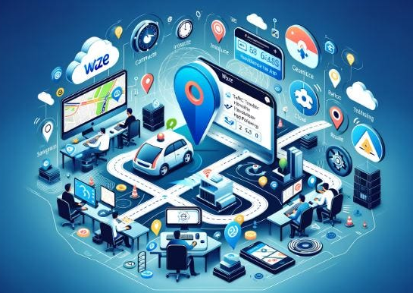
Tailor service to segment
Employ customized strategies-
User engagement
Segmentation
Tiering
Enhancement

Slide 13
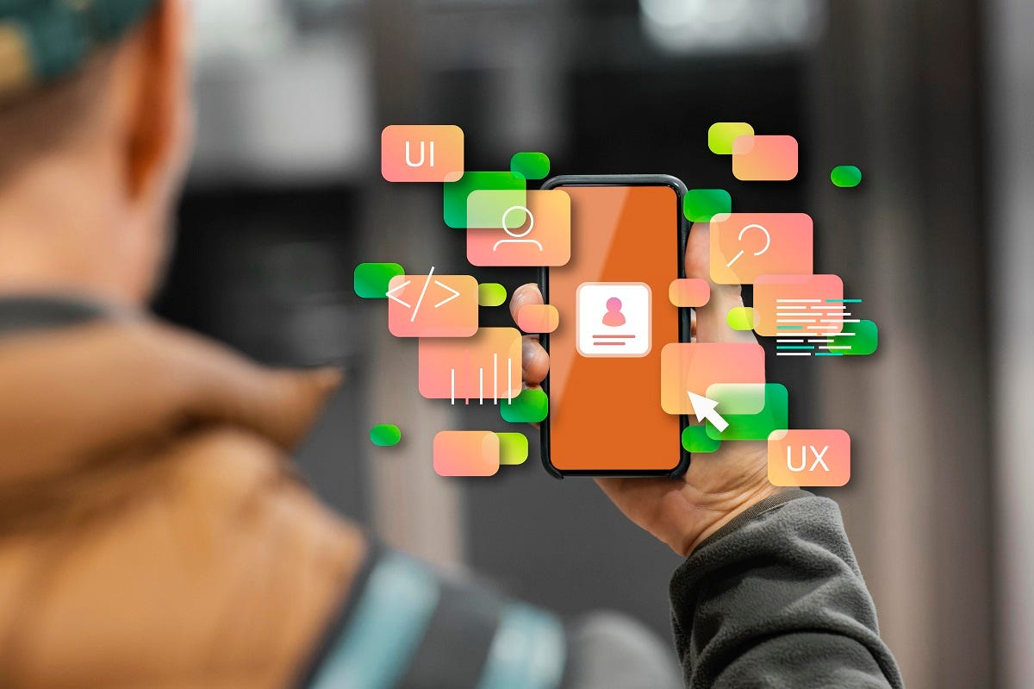
Shift customer-side complexity
Voice-activation for address and POI selection.
Multi-modal route planning with automated ETAs across transportation modes.
Real-time arrival time sharing with automatic updates via Waze.

Slide 14
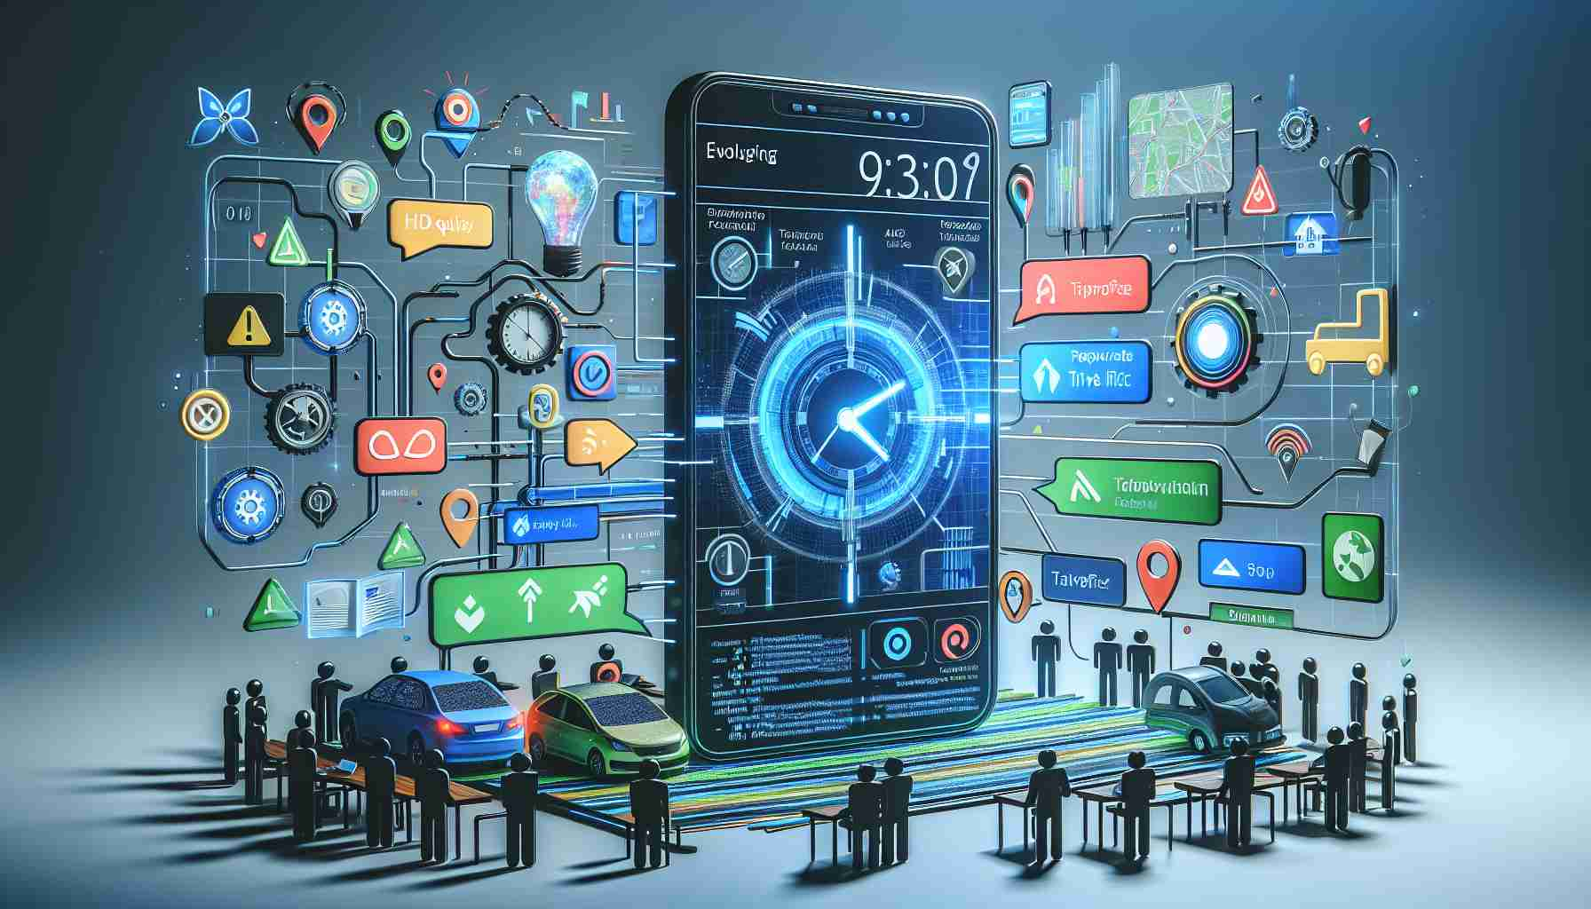
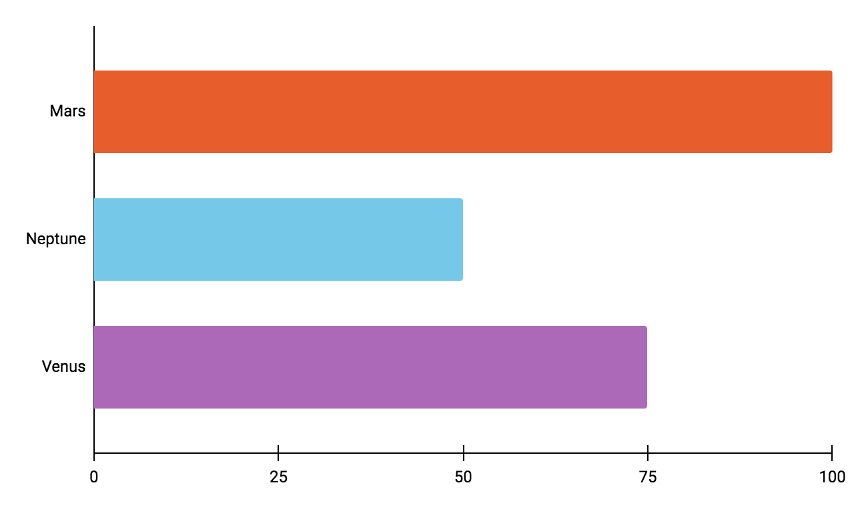
Remove slack rope
Lean work design
Six Sigma Analysis
IT Infrastructure
VSMs
PBCs
IT

Slide 15
Enhancing Customer Job Priorities through Proposed Improvements

Slide 16
Service easier
Effortless destination selection
Streamlined Interface
Automated Navigation

Slide 17
Tailored Predictions
More Consistent/ Reliable
Route Optimization
Dynamic Precision

Slide 18
Faster
Efficient navigation
Mode-specific ETAs
Real-time sharing

Slide 19
More Complete
Social navigation
Multi-modal ETA
Smart integration

Slide 20
Cost Reduction
MARGINAL PRICE REDUCTION
AUTOMATION
CUSTOMER
ACQUISITION
DATA
UTILIZATION

Slide 21
OVERALL IMPACT
Increased Customer Value
Increased Service Profitability
Sustainable Growth

